Slide 1

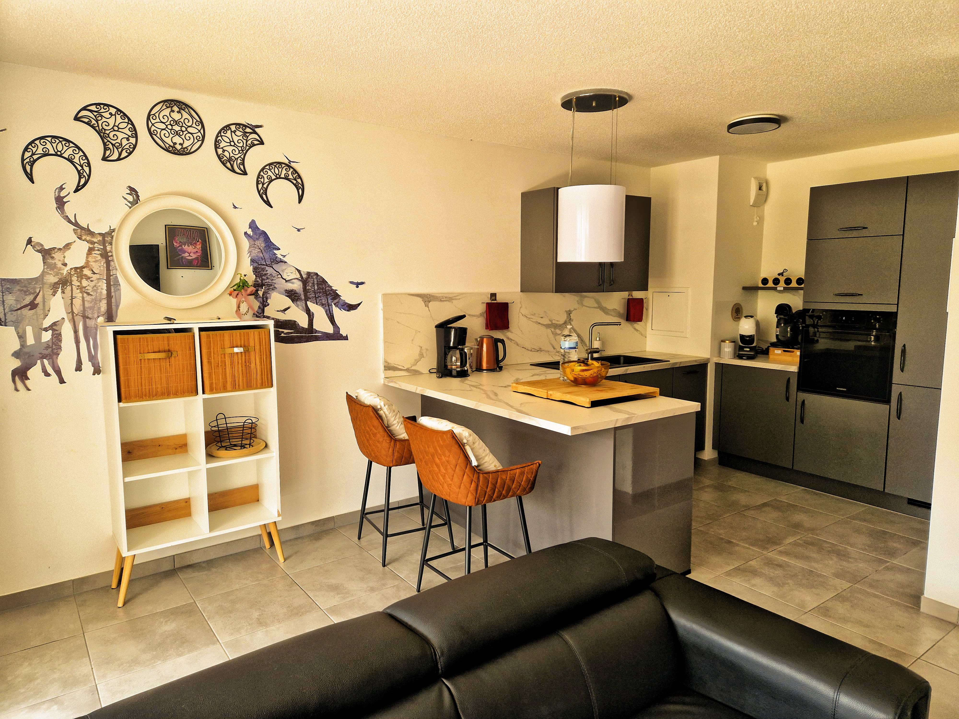
WELCOME TO ESCALE ROMANTIQUE
Your arrival guide
8 Allée Publius Rufrenus • Strasbourg
This guide takes you step by step to the apartment, the key box and your parking space.
We wish you a smooth arrival and a wonderful stay in Strasbourg.
Escale Romantique • Arrival guide • 1

Slide 2
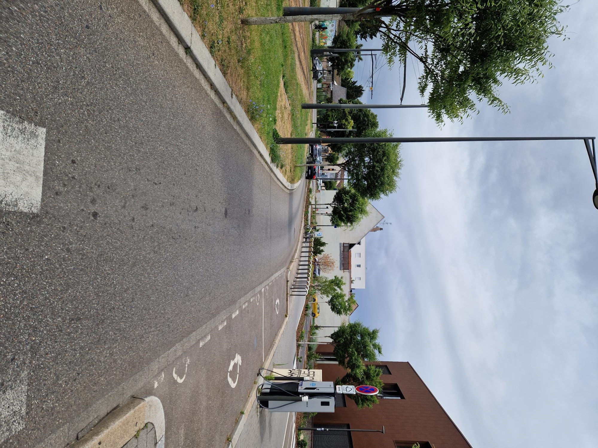
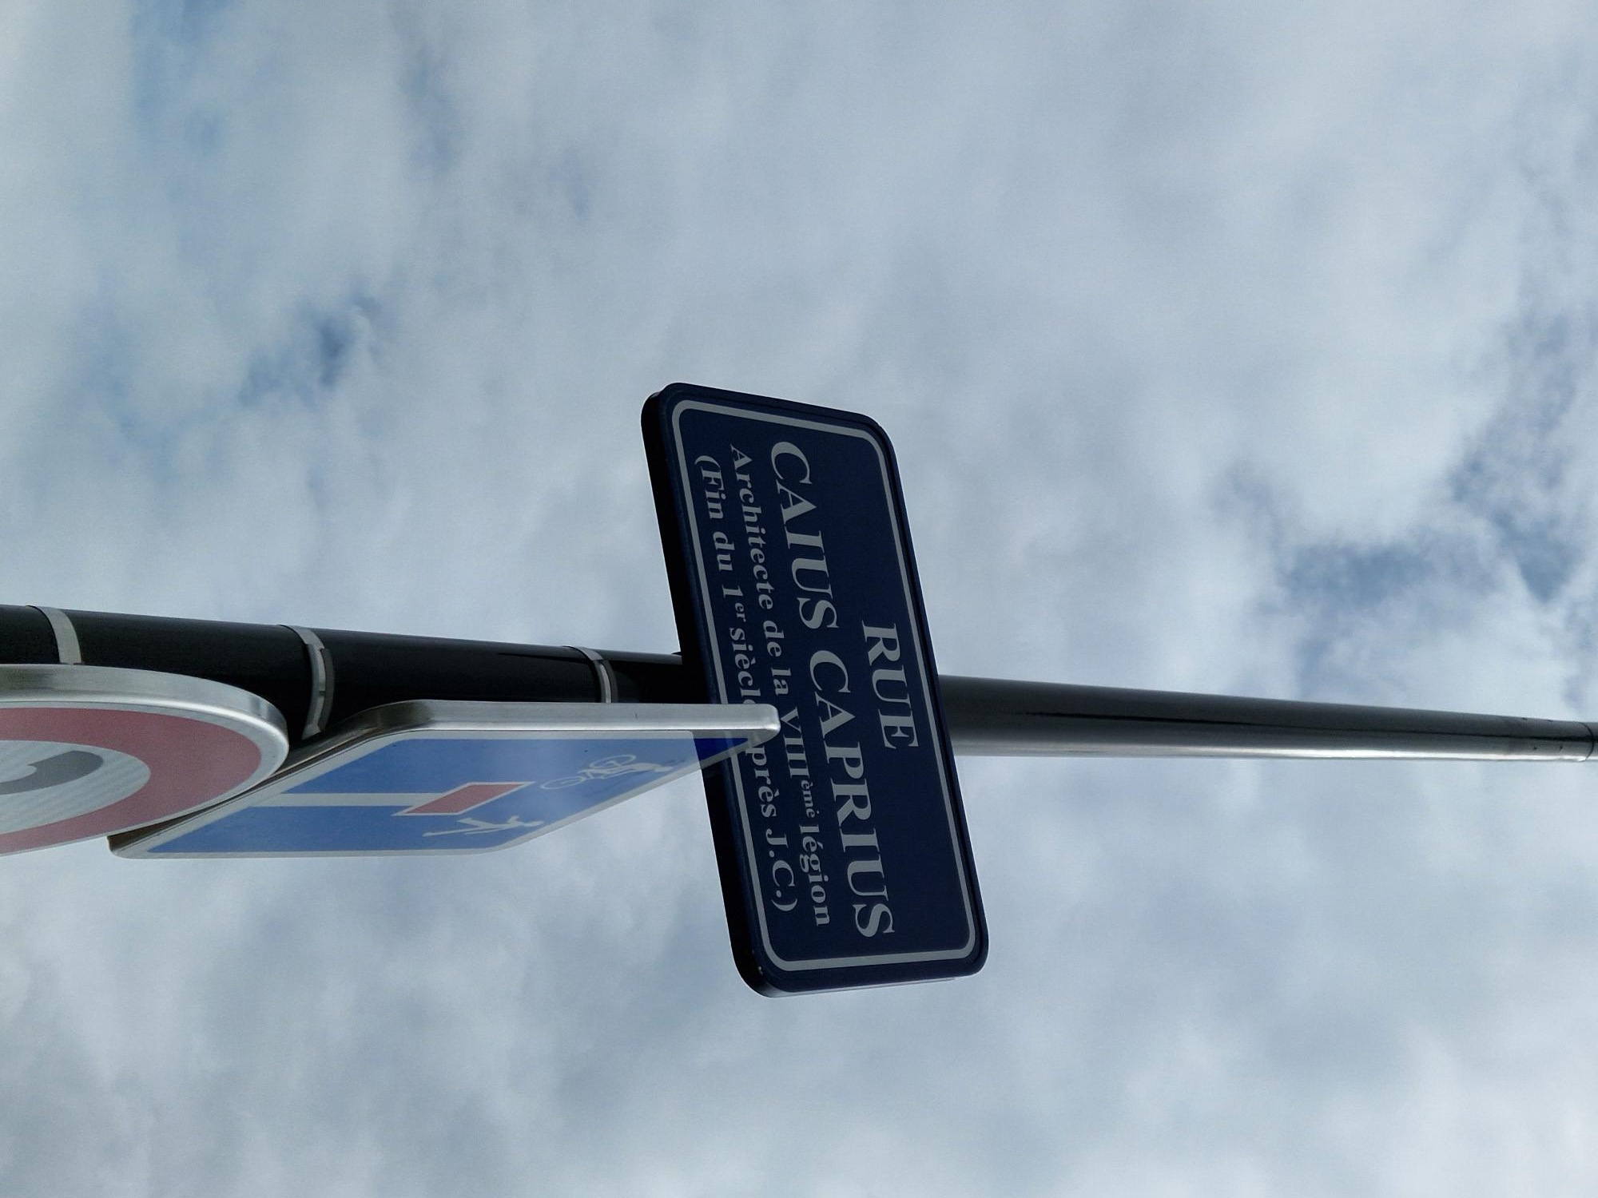
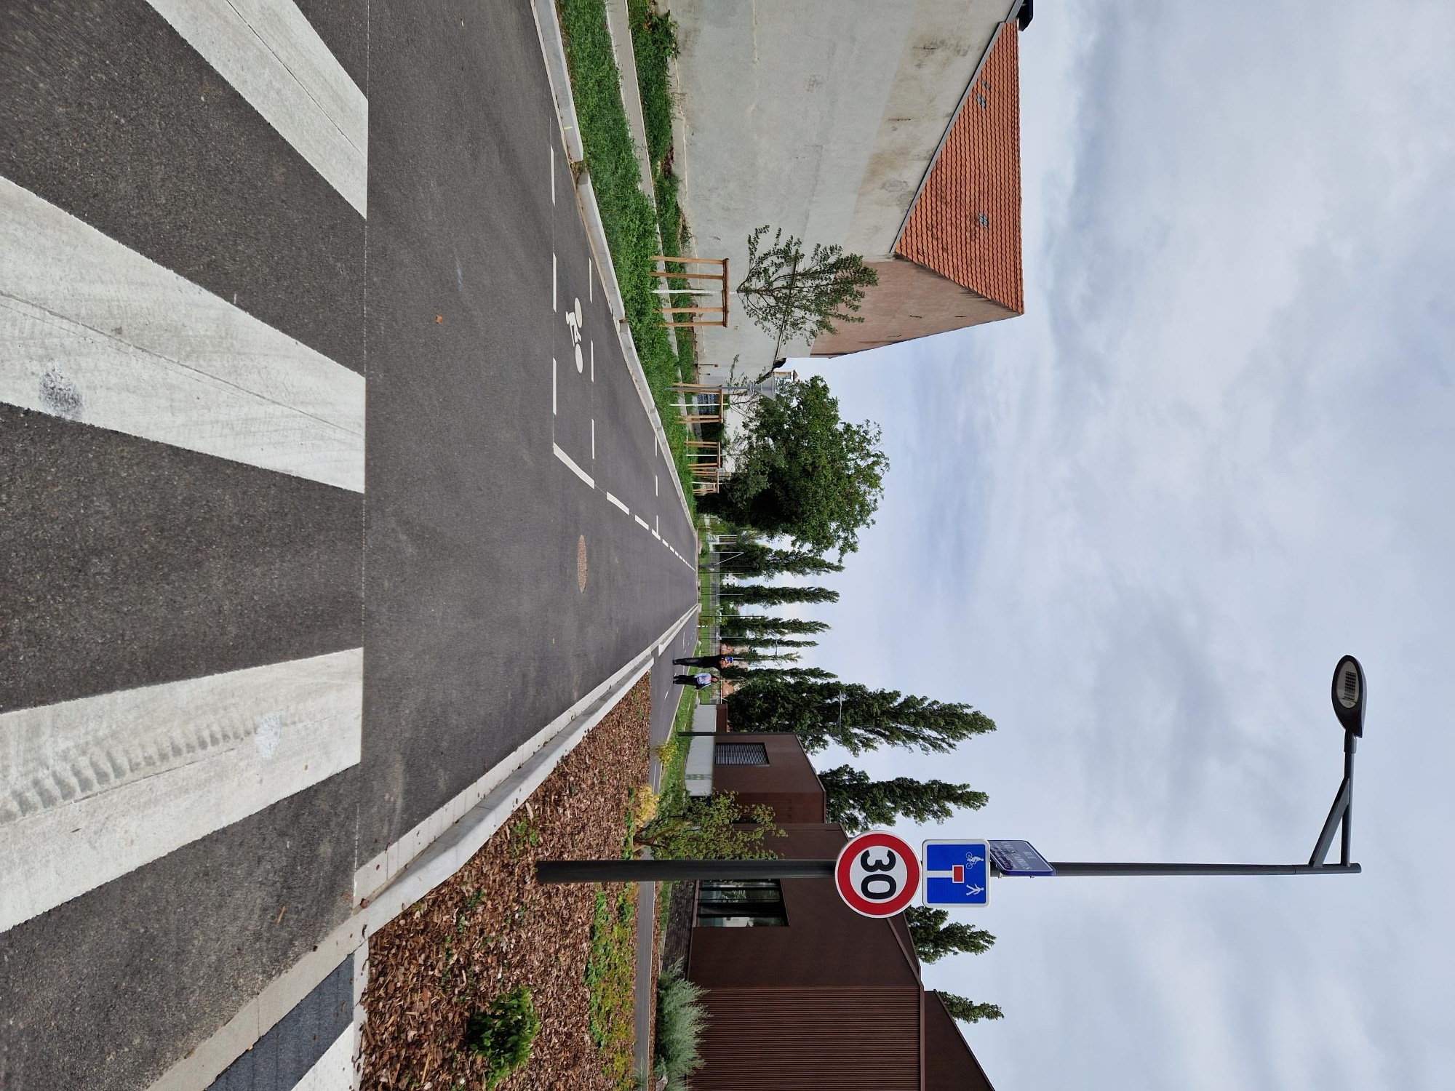
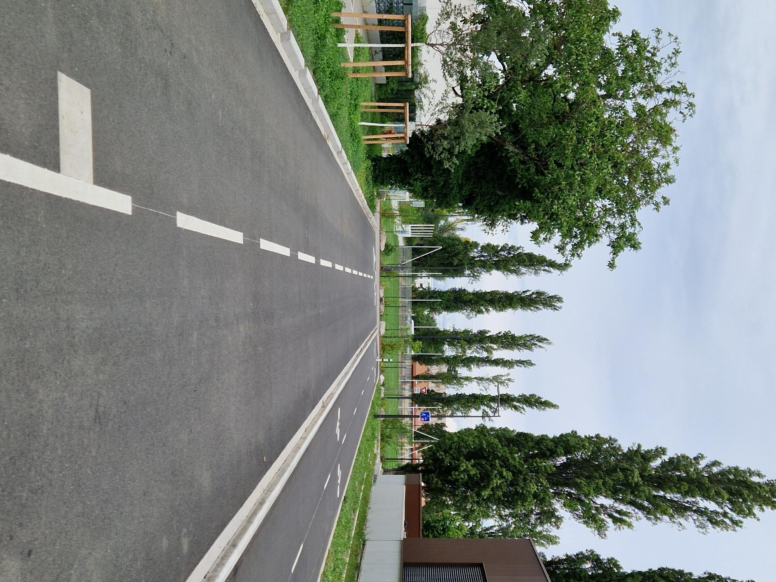
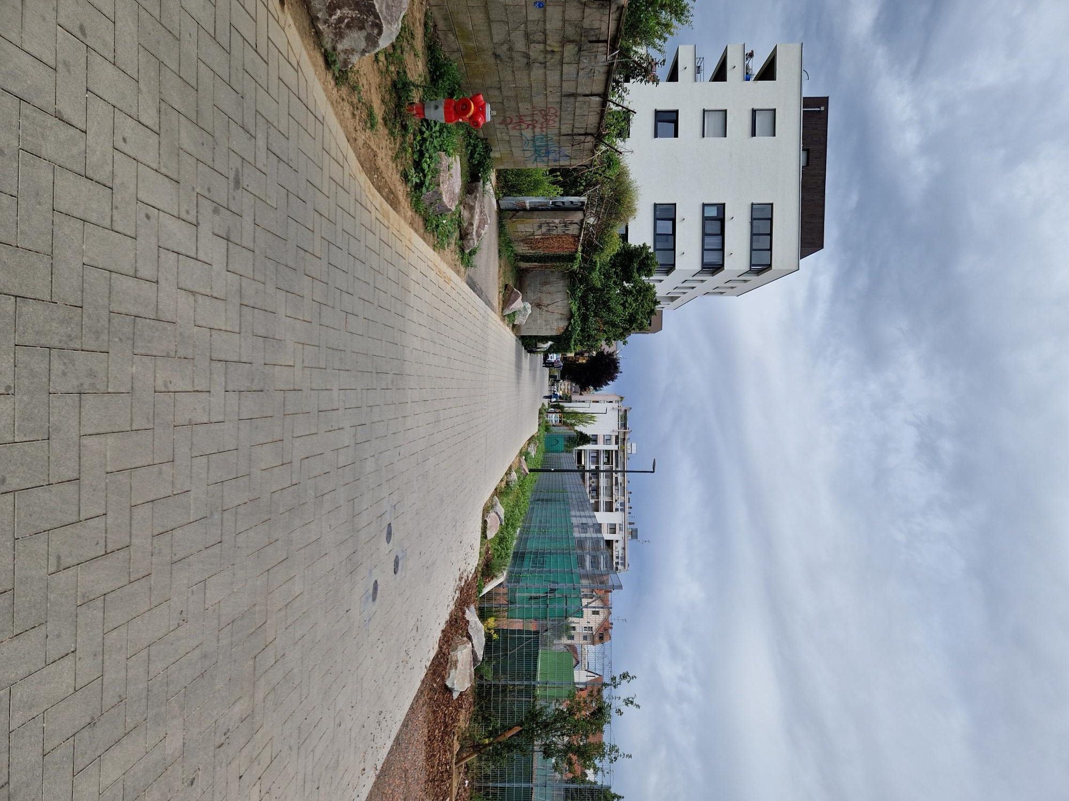
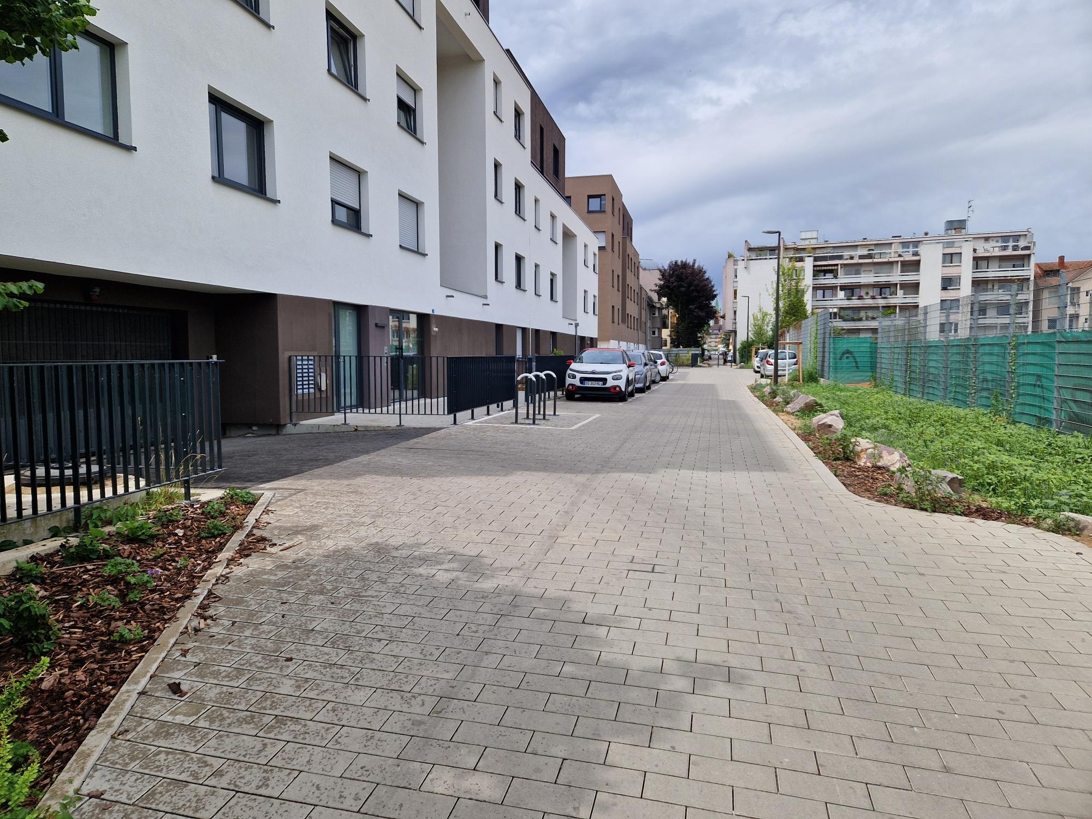
GETTING TO ALLÉE PUBLIUS RUFRENUS
1
From Route des Romains, just after the EV charging station, turn right onto rue Caius Caprius. Continue to the end, then turn left into Allée Publius Rufrenus.
Route des Romains, after the charging station
Turn onto rue Caius Caprius
Turn onto rue Caius Caprius
Continue to the end
Turn left
Allée Publius Rufrenus
Escale Romantique • Arrival guide • 2

Slide 3
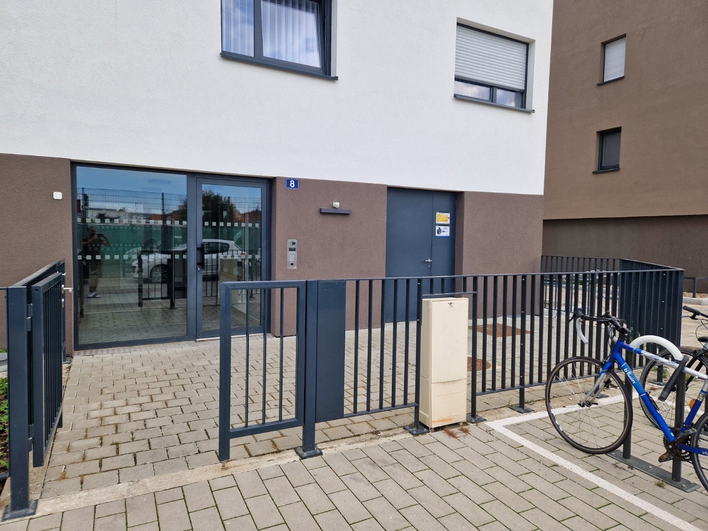
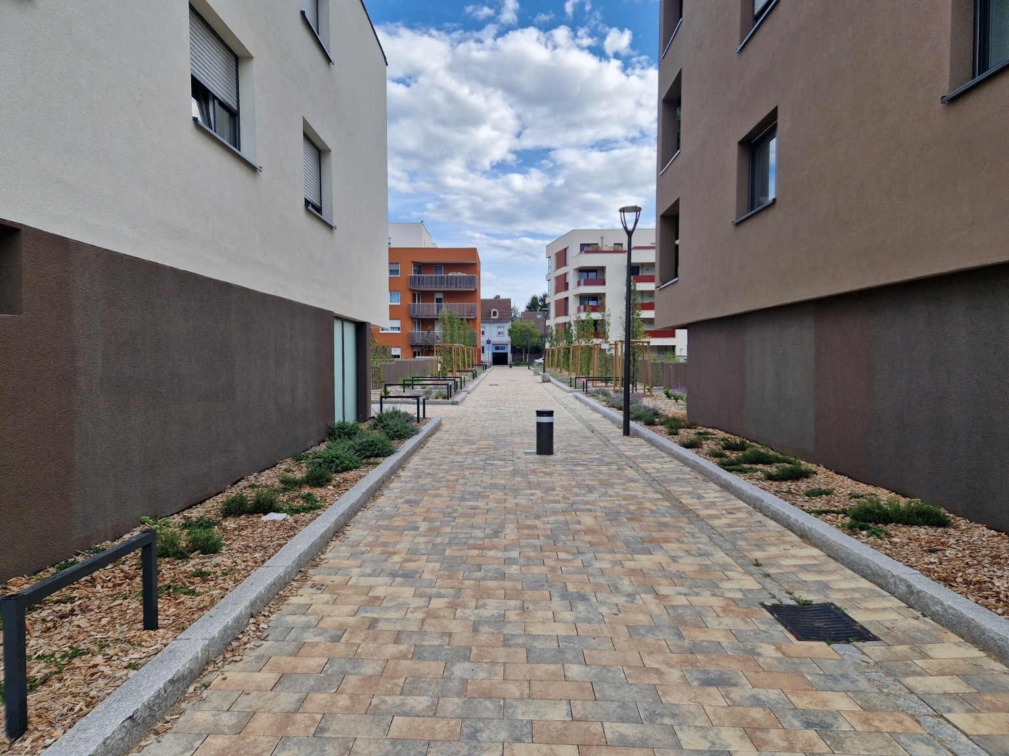
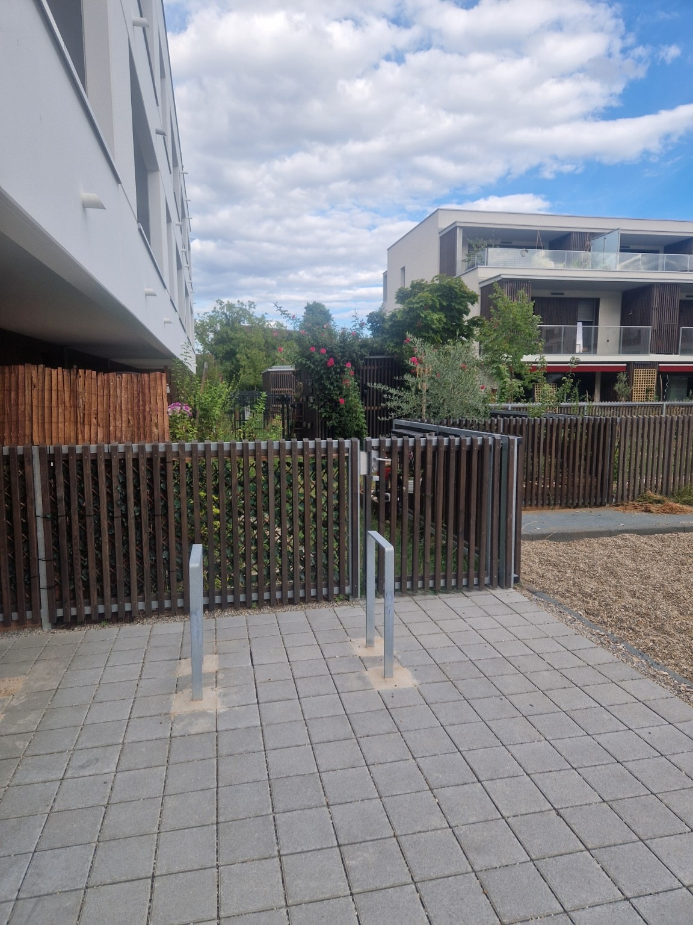
ARRIVING AT NO. 8 AND GARDEN ACCESS
2
At the end of the lane, you will reach 8 Allée Publius Rufrenus. Facing the building, immediately take the passage on your right to reach the garden.
You have reached no. 8, facing the building
Passage on the right
First garden ahead on your left
Helpful tip: stay on the garden side and continue towards the gate and garden shed.
Escale Romantique • Arrival guide • 3

Slide 4
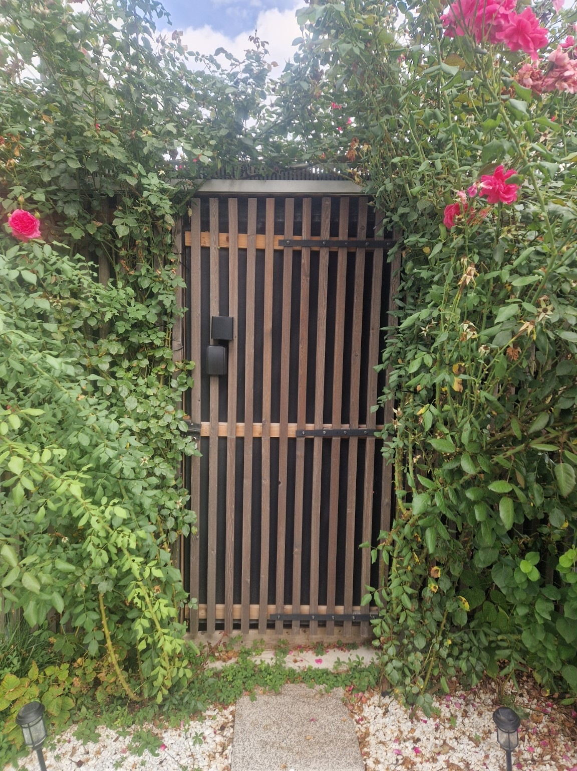
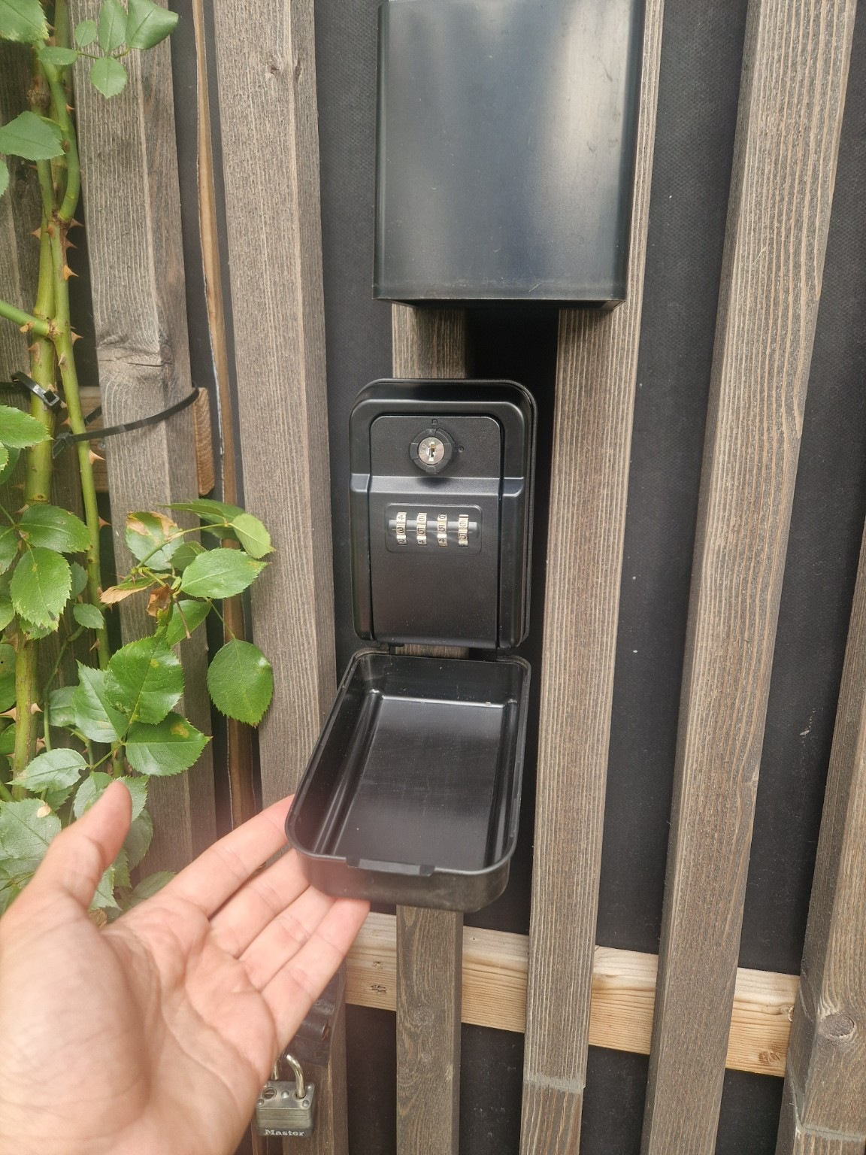
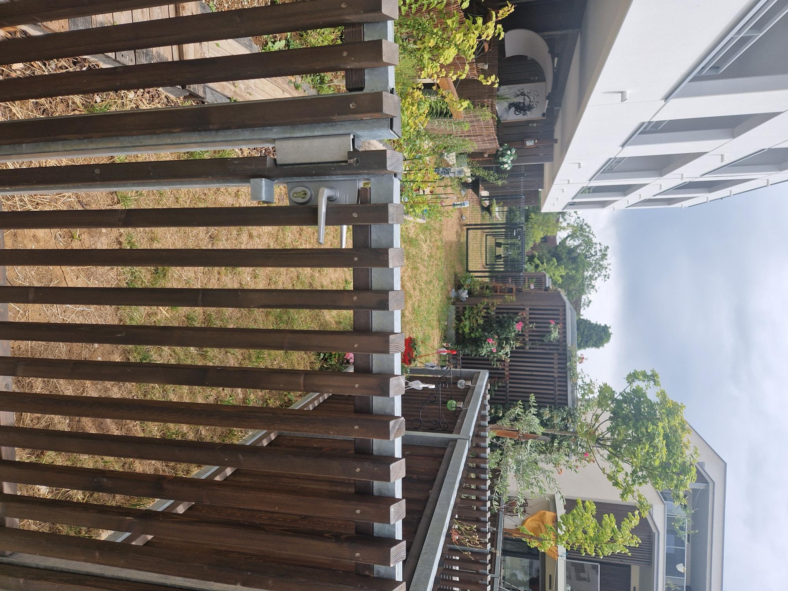
COLLECTING THE KEY
Once in the garden access, use the gate on your left. Beyond it, you will find the garden shed with the key box. The key is inside; the code will be sent to you by message.
Gate
Garden shed
Key box
The key-box code will be sent to you by message before your arrival.
After collecting the key and access badge, you can enter the underground car park if arriving by car.
Escale Romantique • Arrival guide • 4

Slide 5
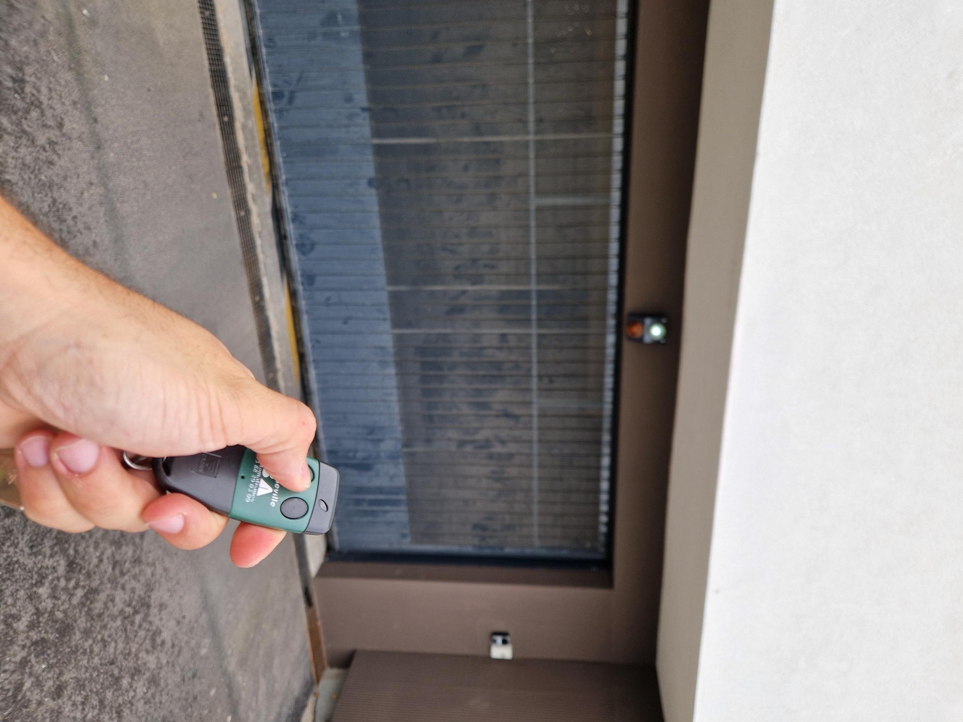
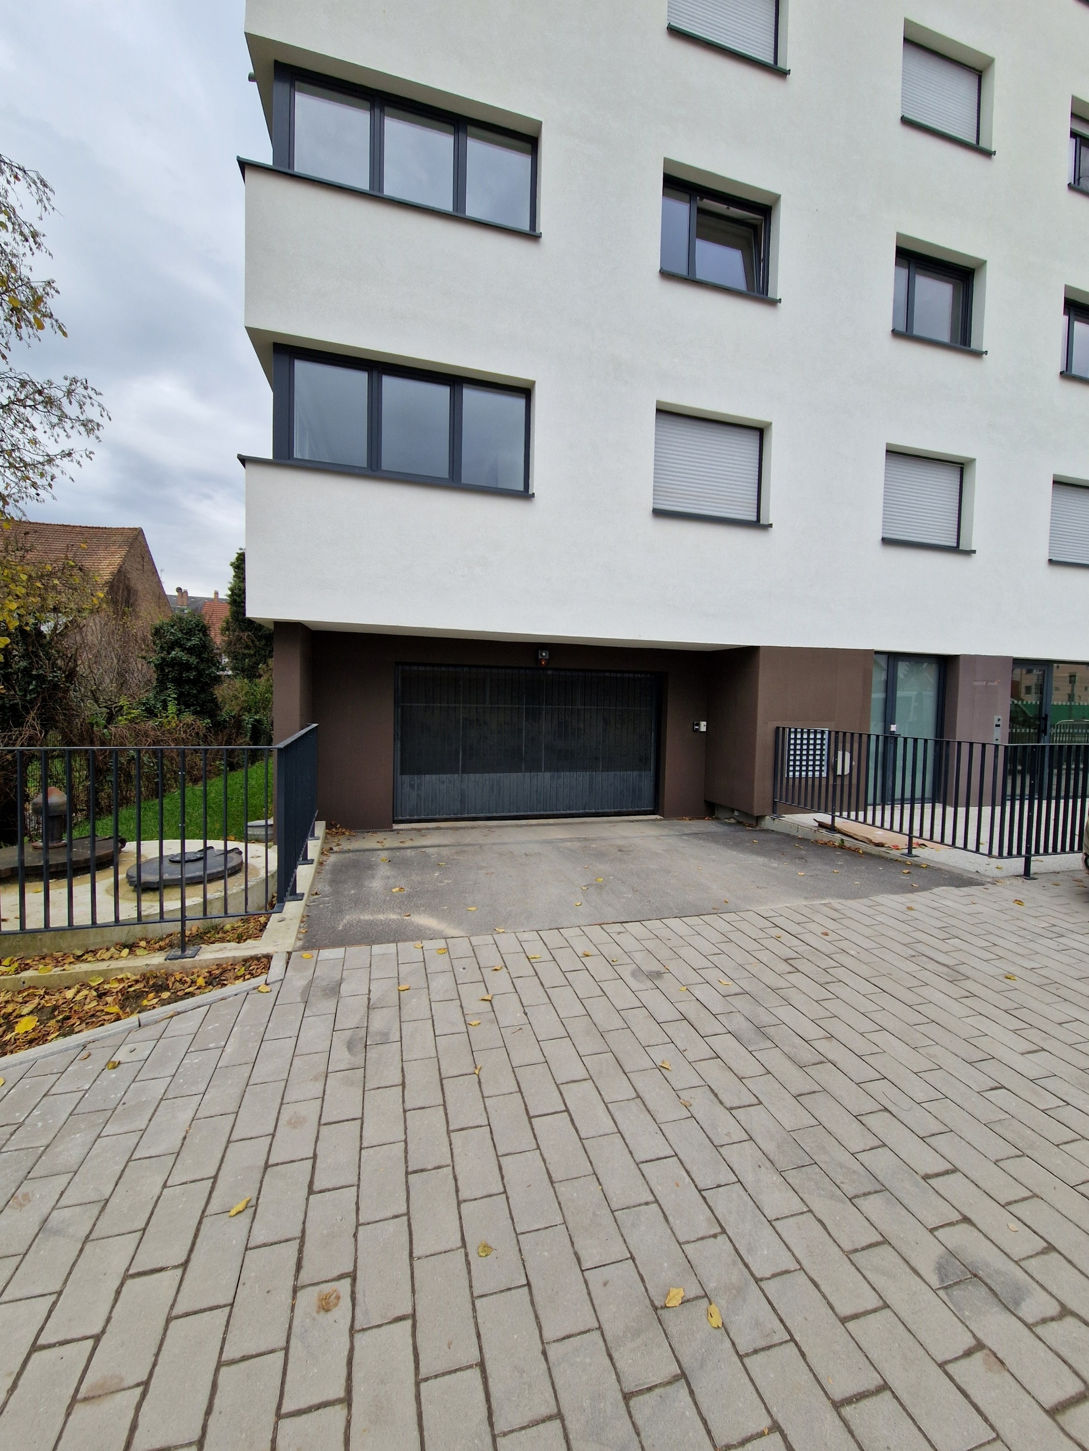
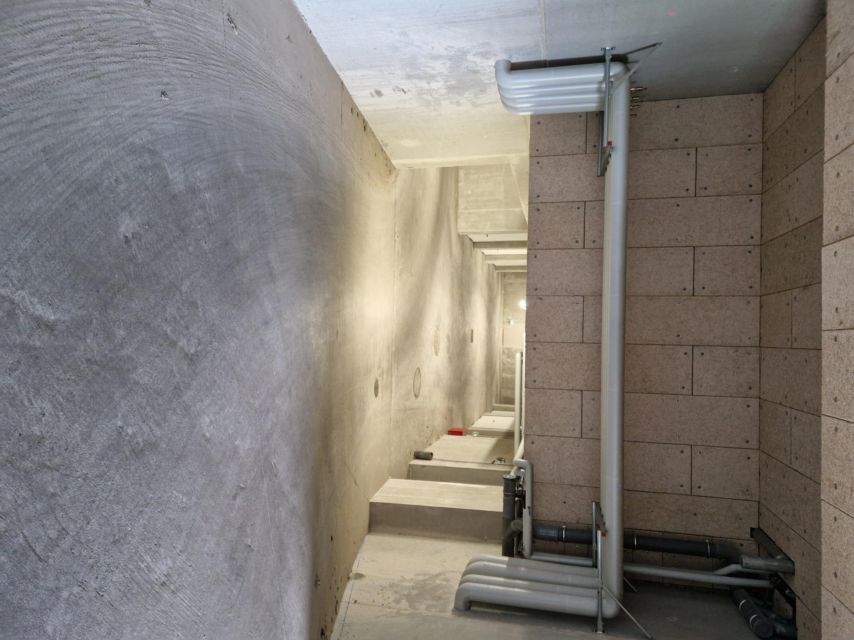
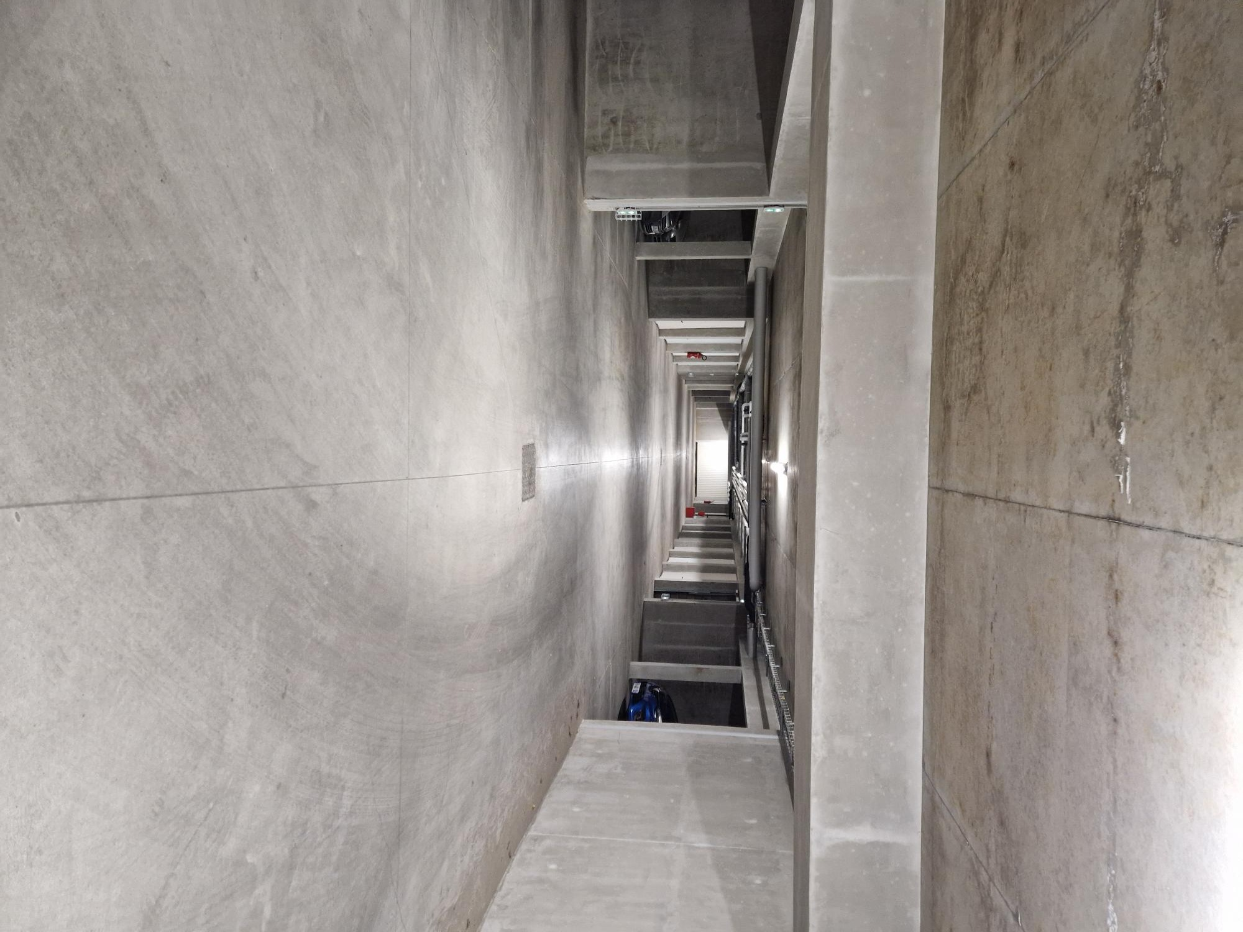
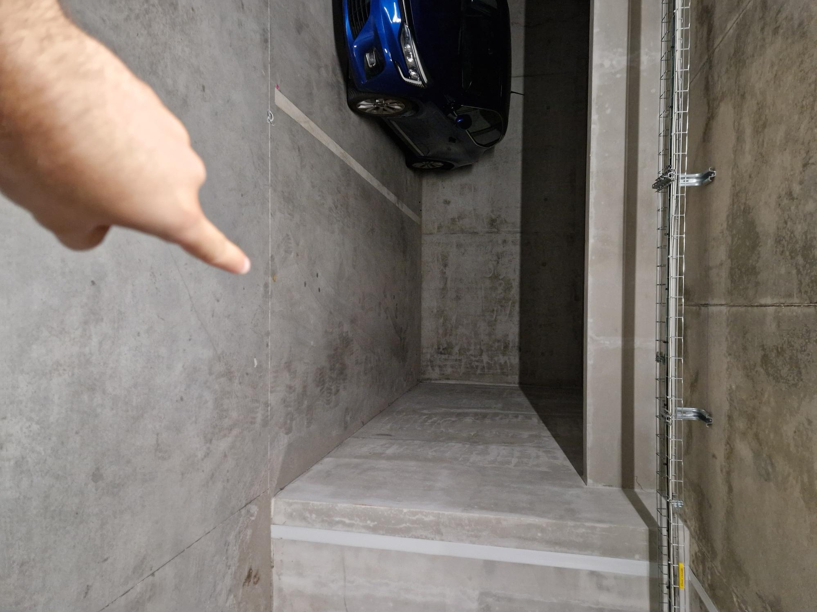
ACCESSING THE UNDERGROUND CAR PARK
3
After collecting the badge, go to the first parking entrance on your left in Allée Publius Rufrenus. Drive down the ramp and turn left: your space is the first one on the right.
Parking entrance
Use the badge
Drive down the ramp
Turn left
First space on the right
You have arrived! All that remains is to enjoy your stay at Escale Romantique.
Escale Romantique • Arrival guide • 5

Slide 6
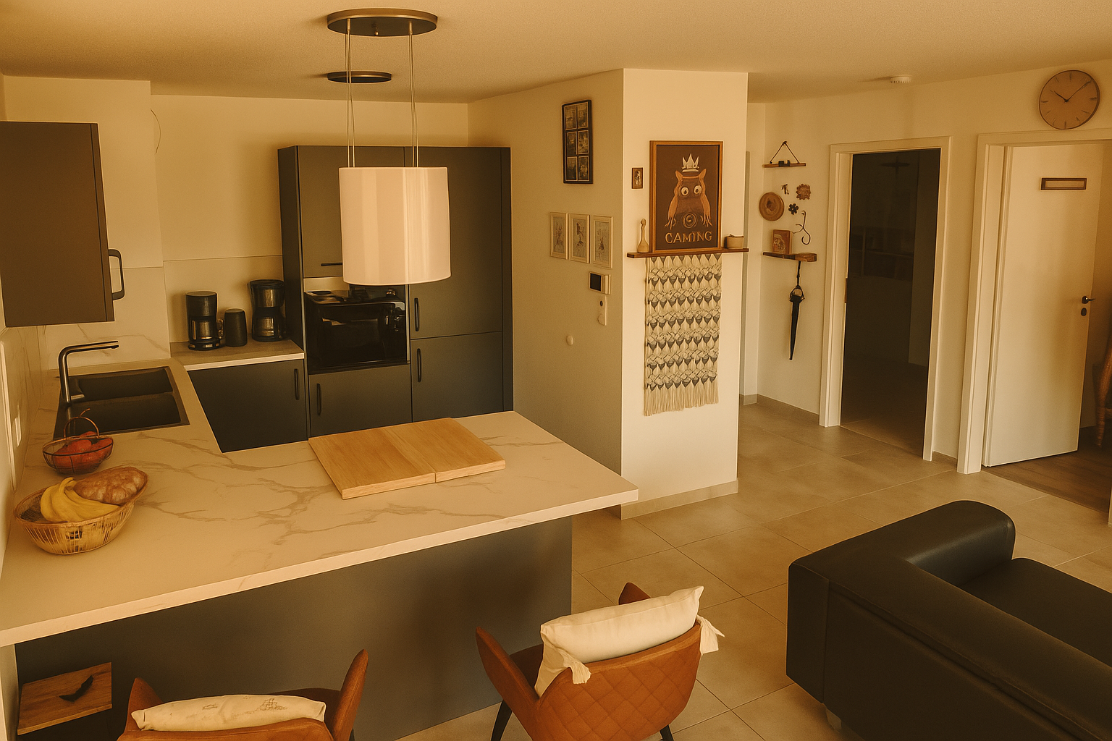
ENJOY YOUR STAY AT ESCALE ROMANTIQUE
Your arrival at a glance
1
Route des Romains → rue Caius Caprius → Allée Publius Rufrenus
2
At no. 8 → passage right → gate left → key box
3
With badge → first parking entrance left → ramp → first space right
Escale Romantique • Your dream apartment in Strasbourg
Escale Romantique • Arrival guide • 6

